Slide 1
MagSail CubeSat Flight Experiment
Revision 05 (1U CubeSats)
Jan 21, 2021
(Revised mass budget, smaller battery)

Slide 2
High-level requirements
Design a CubeSat flight experiment to test the hypothesis that magsails can serve as a viable deorbit method for satellites in Low Earth orbits (700-1400 km).
Design drivers:
low-cost
flexible and frequent launch options,
ability to conclusively detect the magsail drag effects
simple deployment mechanism,
possibly demonstrate deorbit (re-entry) in 100 days
use proven COTS parts with flight-heritage

Slide 3
Baseline mission concept
The reference design consists of 2 “1U” cubesats to start with, with minimal capability
to see what can be done with 1U (“minimal” experiment)
Cubesat #1 has magsail energized with 1.4 W.
4 deployable booms 50 cm each creates current “square”
Magsail On during sunlight, off during eclipse
Other cubesat will not have magsail turned on.
Both satellites should drift by several thousand kilometeres in about 3 weeks (to be checked at the end).

Slide 4
Key trades (1 of 2)
Orbit altitude: 420 km, 750 km, GTO
selected primarily due to ease of access and magsail effectiveness
Form factor: 1U, 1.5U, 2U, 3U
to see what can be done with 1U
Number of satellites: 1, 2
two identical satellites with one magsail energized will be able to conlusively detect the effect of magsail drag and cancel out aerodynamic drag, solar radiation pressure etc.
Attitude control: none, passive (permanent magnet, gravity gradient, spin about max MoI axis), active (mag.torquer, reaction wheels)
no driving attitude requirements, passive for low cost
lightweight permanent magnets can align one axis with the Earth’s field, and improve downlink, more reliable GPS lock.

Slide 5
Key trades (2 of 2)
Solar panels: fixed, deployable, articulated
low cost, reliable
Batteries: Li-ion, Li-Po,Ni-Cd, supercapacitors
low-cost, high Wh/kg, low vol/kg, high-discharge current, commercial, flight-heritage
Telecom: UHF (ground station), L-band (Iridium).
low cost, less regulatory hurdles, no poiniting required
Antenna: deployable monopole, patch.
flight-heritage
Processor and data handling:
commericial off the shelf, need not be rad hard, redundancy with cross-strap architecture

Slide 6
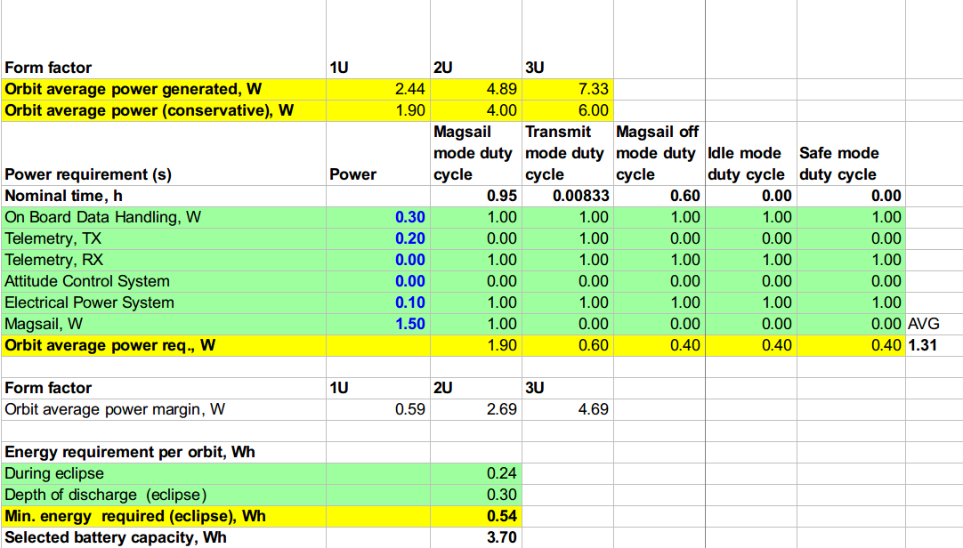
Power (1 of 3) - power budget (revised)
TX on only 0.5 sec per minute, 0.2 W

Slide 7

Power (2 of 3) - Battery (revised)
Lower Wh battery than before, 23 g instead of 100g
Recommend 2 in parallel for redundancy, and higher battery capacity
1 X LG LGIP-520B Li Ion
= 3.7 Wh, 23g, $9
see next slide for battery discharge during operation

Slide 8
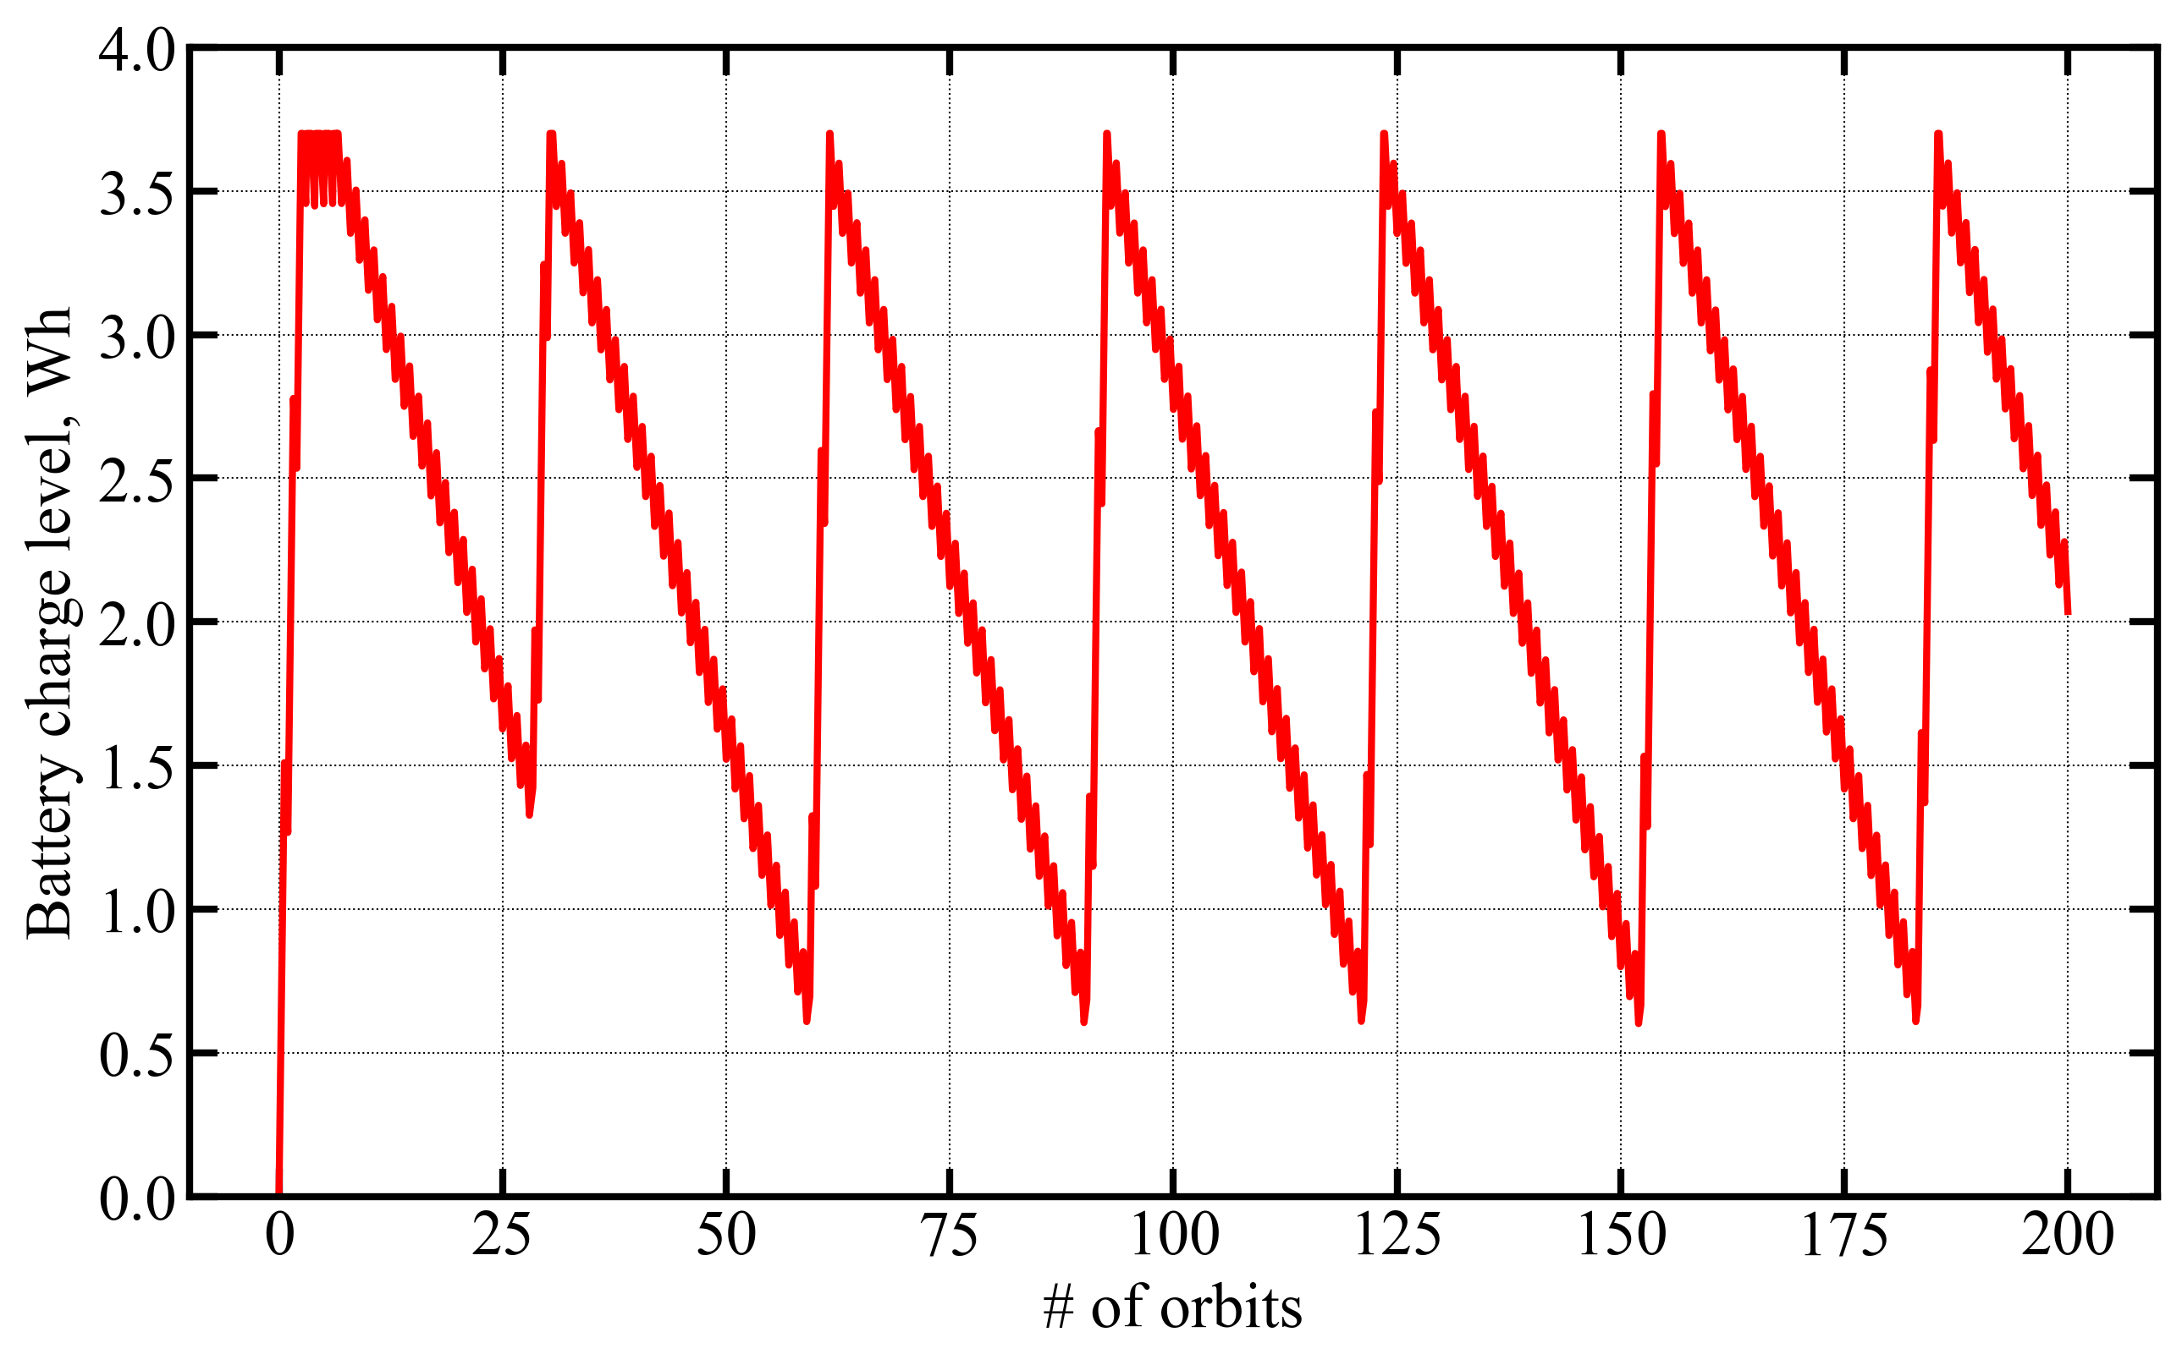
Power (3 of 3) - Battery charge
Magsail ON during sunlight, P = 1.5W
Magsail turned off for 4 hours every 48 hours to replenish battery

Slide 9
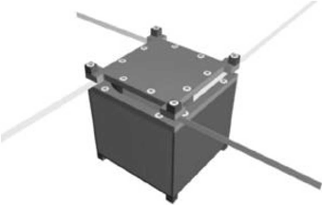
Telecom (1 of 3)
Reference: VHF/UHF, ground station
Nominal TX power: 0.2 W
Duty cycle: 0.5 second beep every minute
Desired data rate: ~ 10 kbps, total data = 5 kb per beep
Link budget in next page
Link has to be closed (margin > few dB)

Slide 10
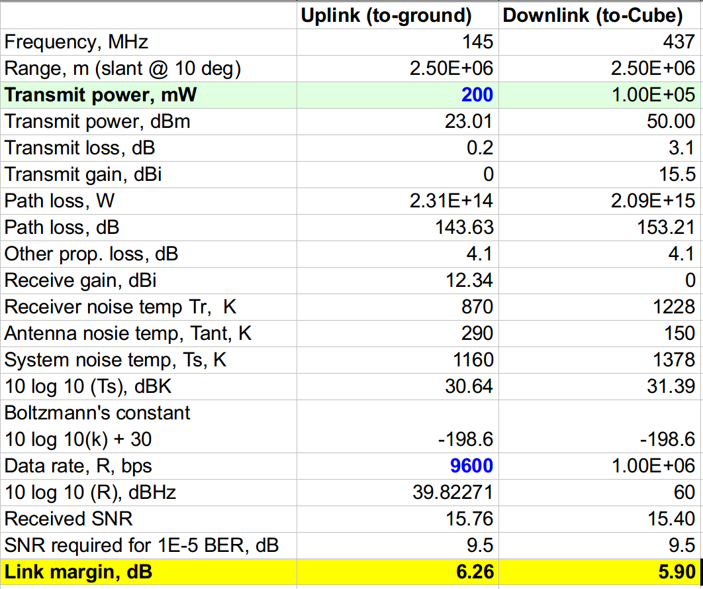
Telecom (2 of 3) - Link budget

Slide 11
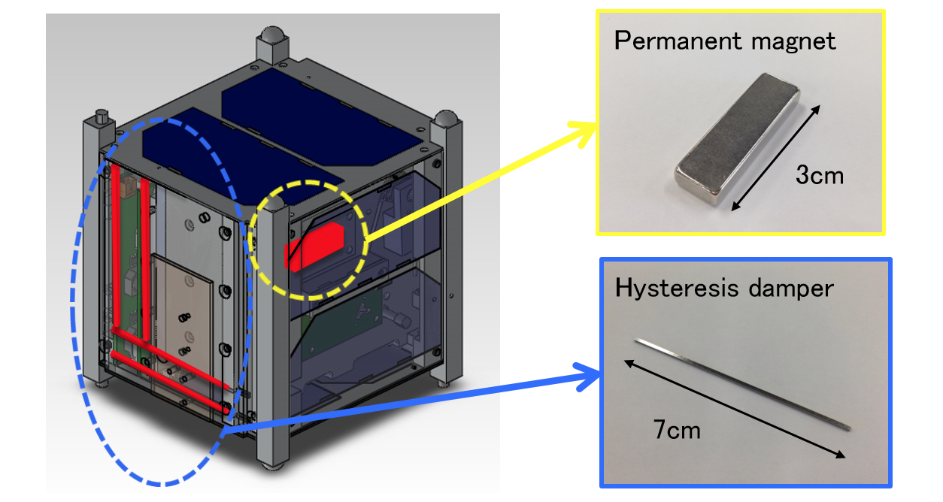
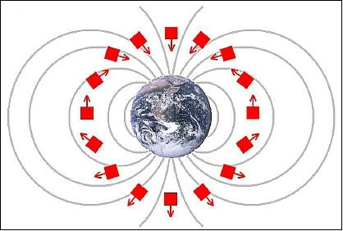
Attitude control (1 of 2)
No attitude control for reference 1U.
Attitude control system not necessary, however more analysis is required. Need to detumble before deployment?
It may help to have a few permanent magnets (< 50 g) along the magsail axis so it stabilizes the magsail axis along the ambient field. (or use magnetotorquers)

Slide 12
Attitude control (2 of 2)
May help data download and GPS reception.
Some addtional analysis is being done.

Slide 13
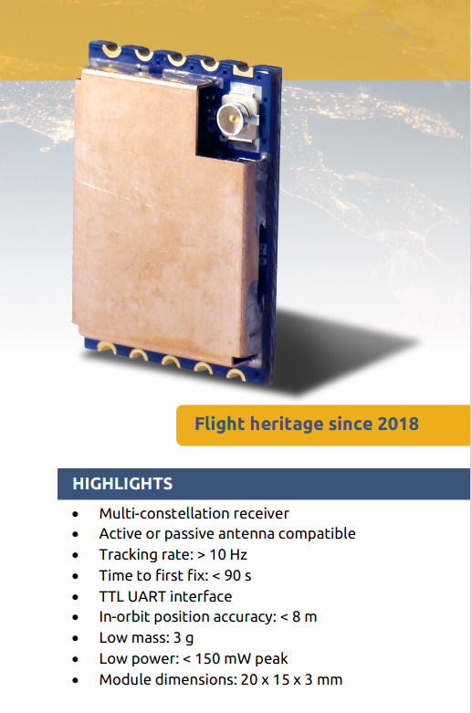
Tracking (1 of 2)
A low mass, low power GPS receiver is added
Mass = 9 g, power = 0.15 W, time to first fix ~ 90s

Slide 14
Tracking (2 of 2)
Other options:
NORAD tracking data
Commercial radar observations (LeoLabs)

Slide 15
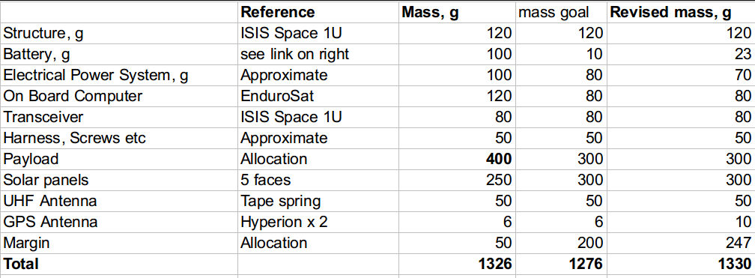
Mass budget (Jan 21)

Slide 16
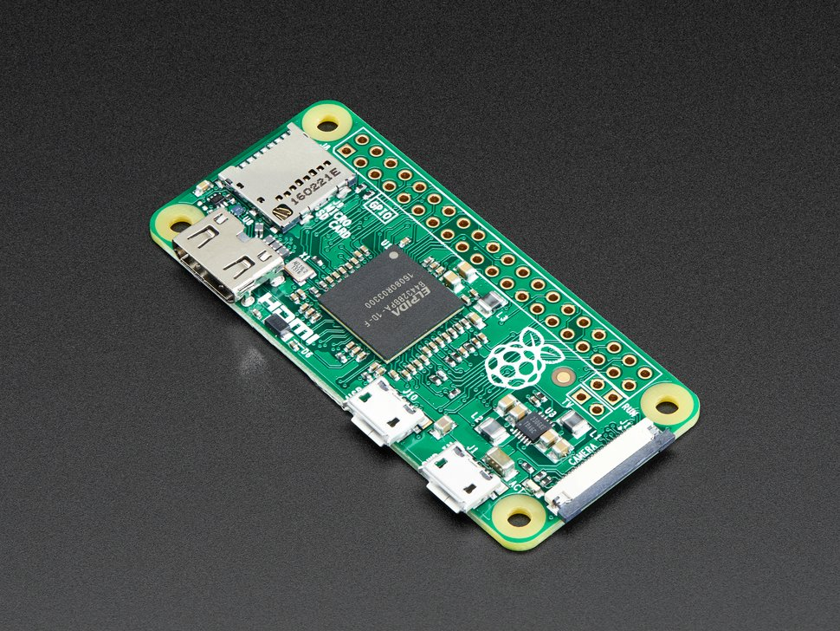
Raspberry Pi as On Board computer?
$20 computer
9g, 0.4W
Can use 2 boards for redundancy

Slide 17
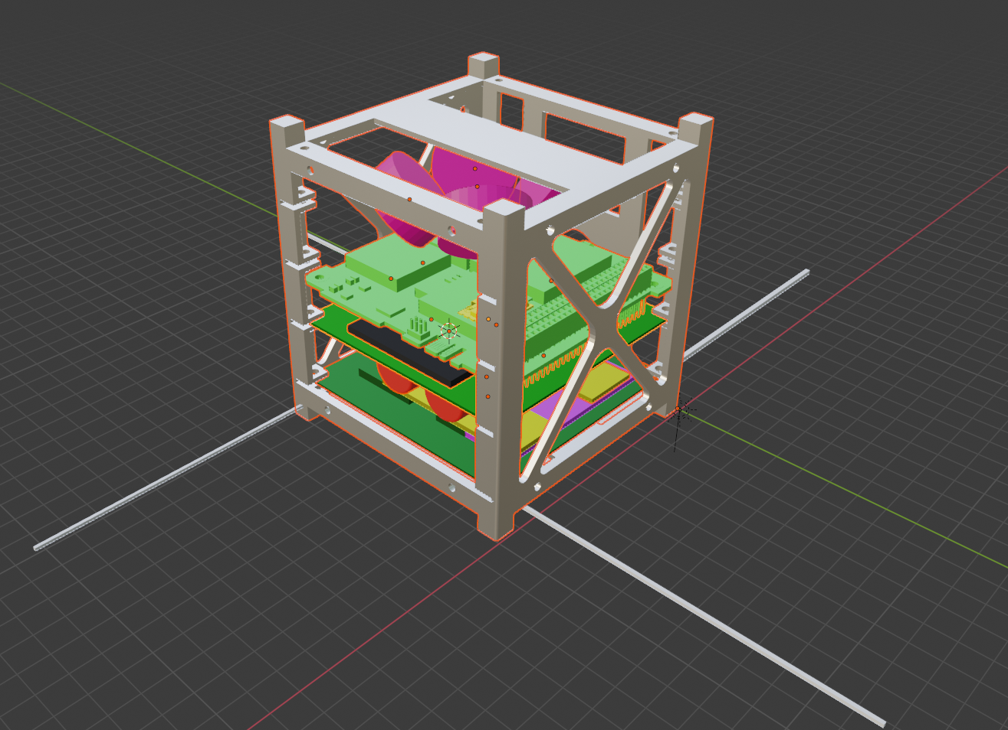
Drawing (Work in progress)

Slide 18
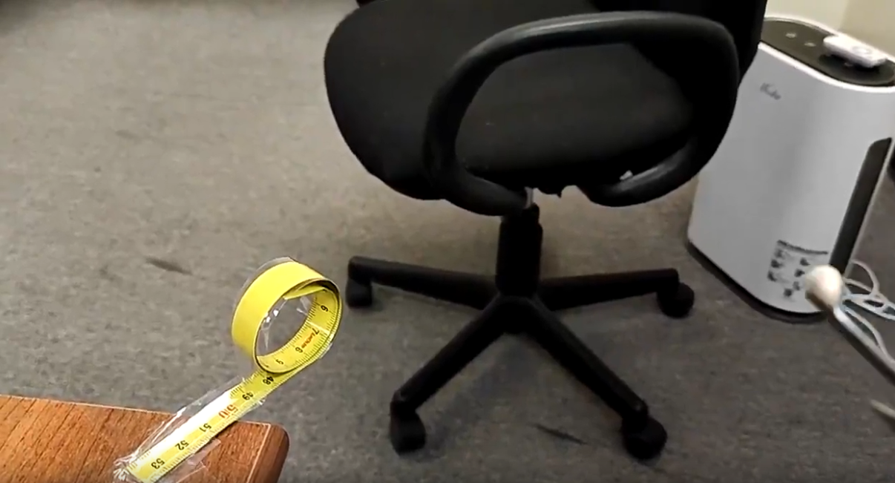
Deployment demo (in progress).

Slide 19
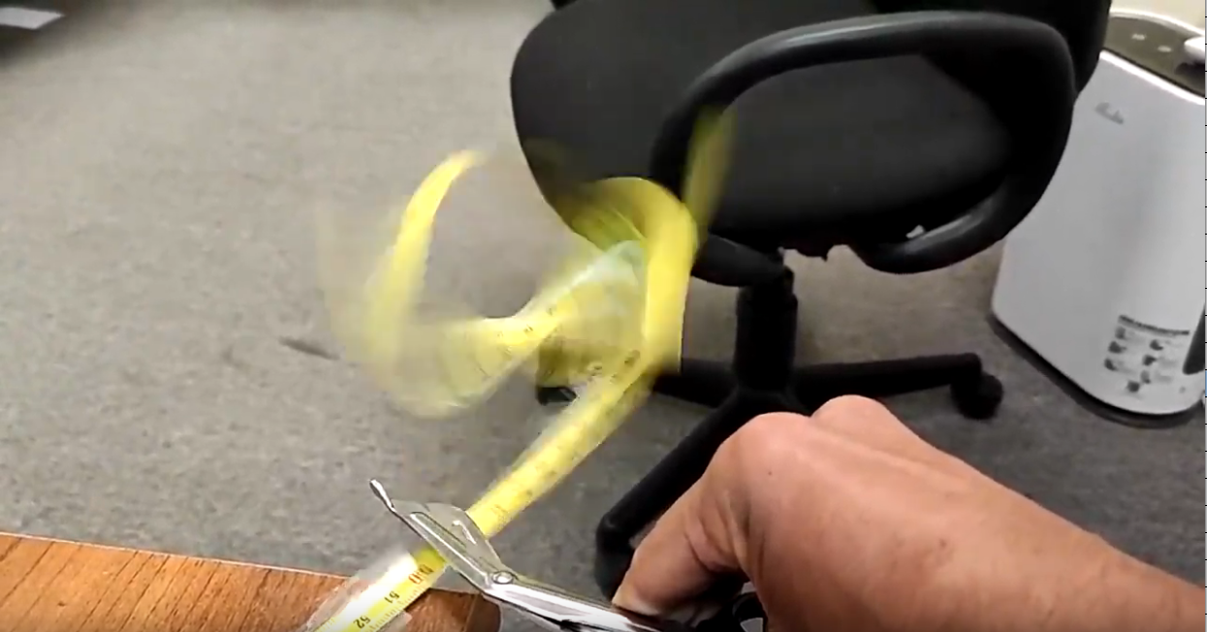
Deployment demo (in progress).

Slide 20
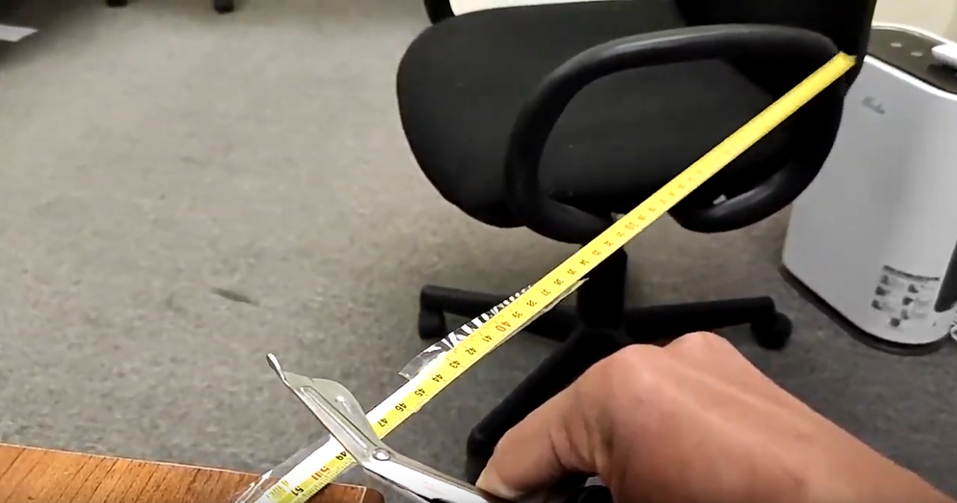
Deployment demo (in progress).

Slide 21
Deployment demo (in progress).
Deployment with rolled up tape spring is unstable, this problem is solved by composite tape springs which deploy much more predictably. However, these are not readily available for purchase. But if we move to a flight experiment, we should be able to get them.
However, we may be able to show some kind of demonstration with ordinary tape spring.
Will try again tomorrow.

Slide 22
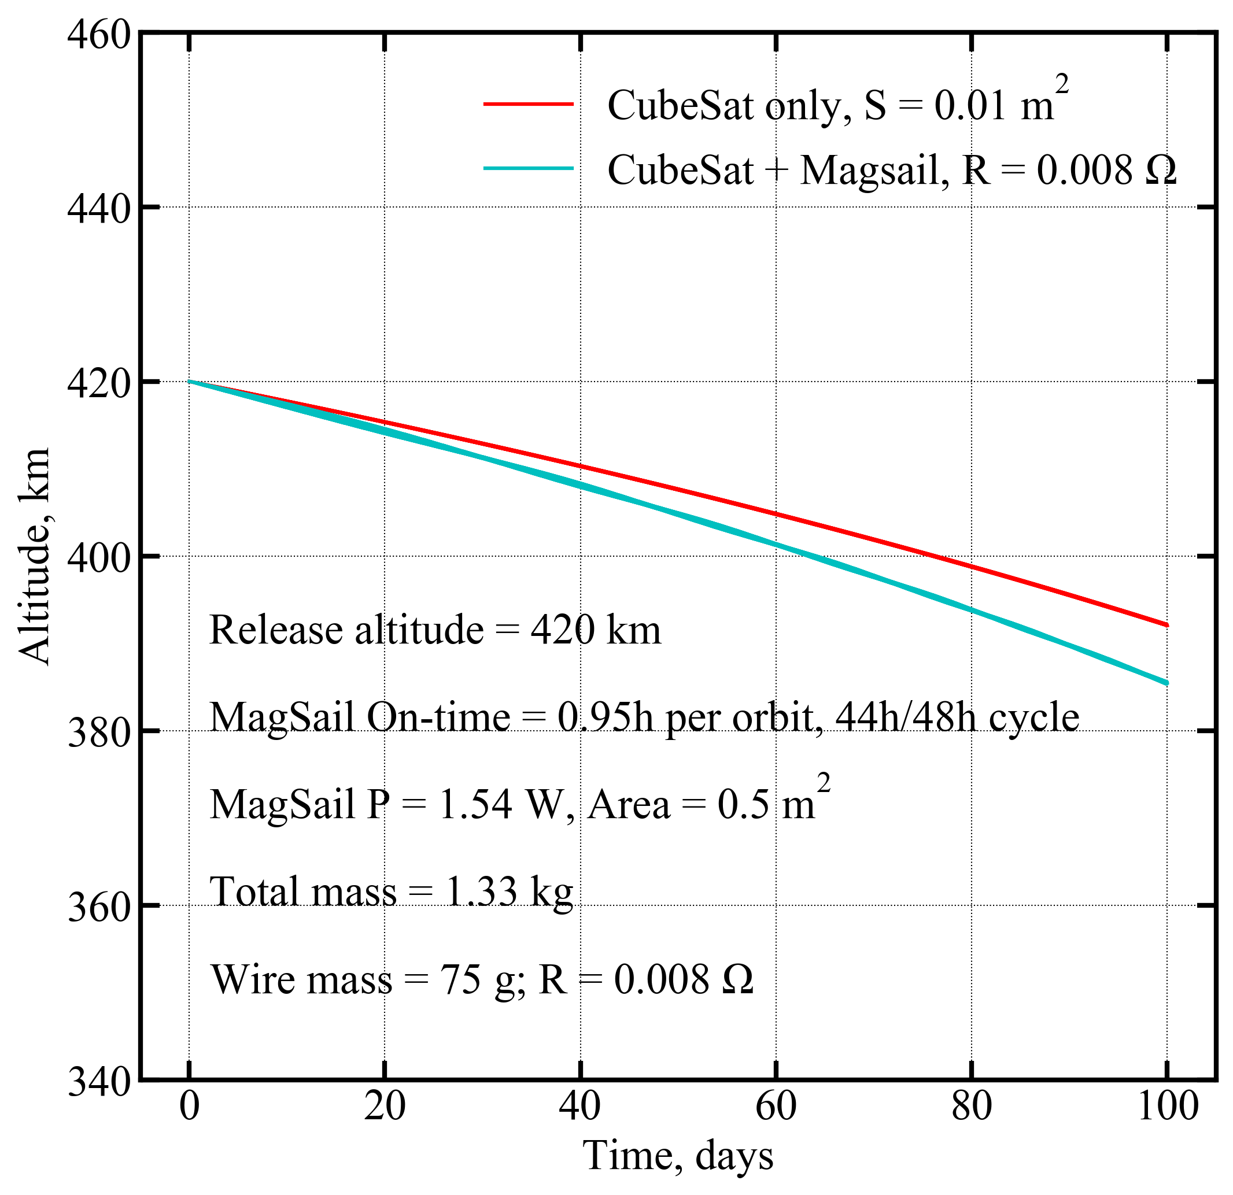
Orbit decay

Slide 23
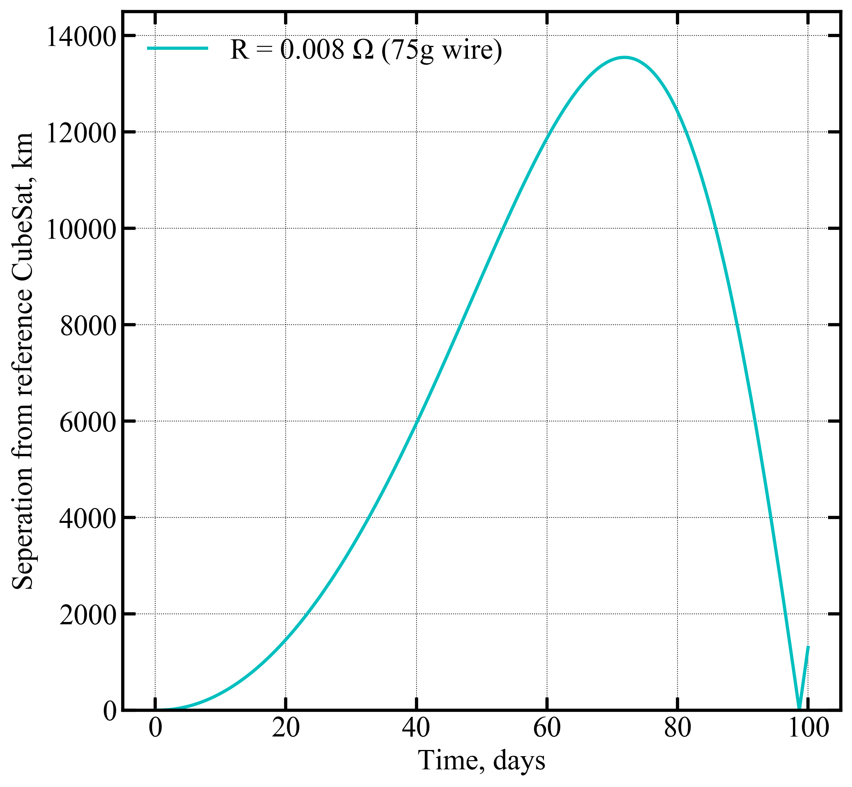
Relative separation

